Slide 1
2024/06/19 Meeting Report

Slide 2
Papers
Implementing gender-dependent vowel-level analysis for boosting
speech-based depression recognition
Notes:
一般 learning rate 都會根據 batch size 做一些 scale 的操作。這裏用的是lr x batch_size / 256」。
Learning rate 小 under-fitting
Learning rate 大 unstable

Slide 3
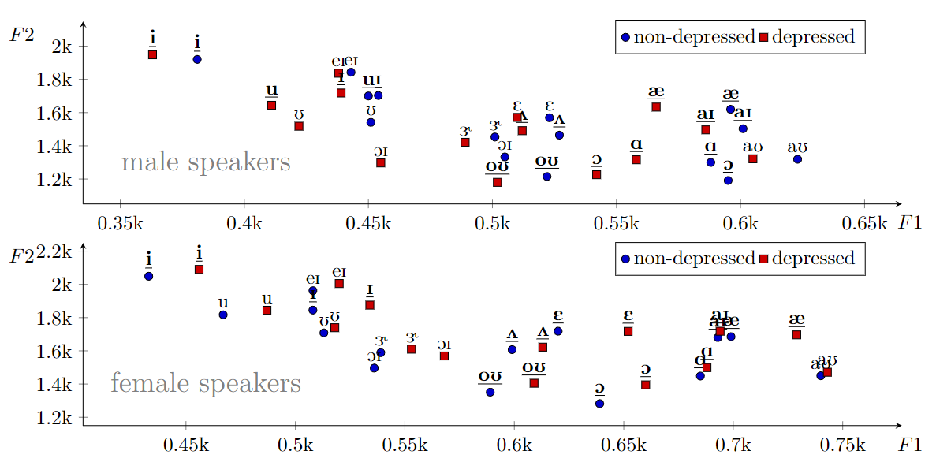
Implementing gender-dependent vowel-level analysis for boosting speech-based depression recognition
統計 DAIC-WOZ 資料集中，男性與女性15種音素(phoneme)的第一、第二共振峰頻率(formant frequency)的平均值
Notes:
一般 learning rate 都會根據 batch size 做一些 scale 的操作。這裏用的是lr x batch_size / 256」。
Learning rate 小 under-fitting
Learning rate 大 unstable

Slide 4
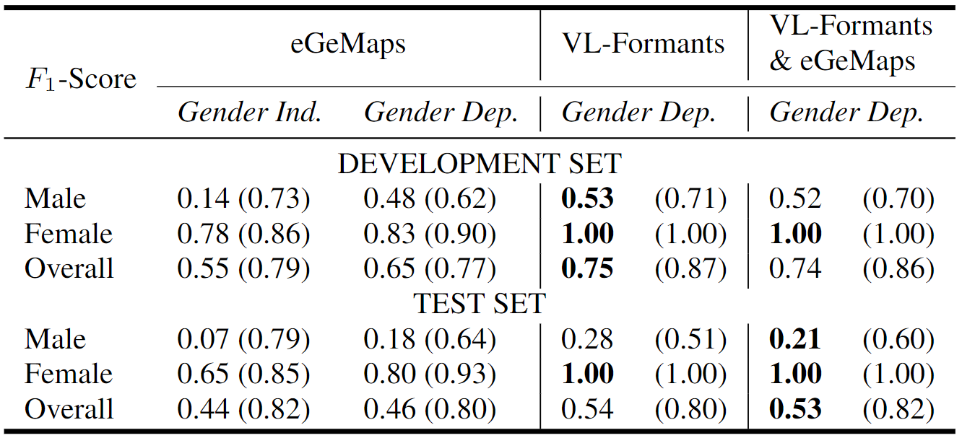
Implementing gender-dependent vowel-level analysis for boosting speech-based depression recognition
使用從語音訊號計算的10種音素的F1、F2作為訓練特徵
訓練男性與女性專用的分類器 (gender-dependent classification)
分類器：簡單的線性回歸(Linear classification)，0.81
Notes:
一般 learning rate 都會根據 batch size 做一些 scale 的操作。這裏用的是lr x batch_size / 256」。
Learning rate 小 under-fitting
Learning rate 大 unstable

Slide 5
Implementing gender-dependent vowel-level analysis for boosting speech-based depression recognition
2021 - Gender Bias in Depression Detection Using Audio Features：0.658
2022 - Unsupervised Instance Discriminative Learning for Depression Detection from Speech Signals：0.6834
2022 - A Step Towards Preserving Speakers’ Identity While Detecting Depression Via Speaker Disentanglement：0.692
2022 - FrAUG: A Frame Rate Based Data Augmentation Method for Depression Detection from Speech Signals：0.656
2022 - Toward Knowledge-Driven Speech-Based Models of Depression: Leveraging Spectrotemporal Variations in Speech Vowels：F1:0.6, Marco F1:0.70
2023 - A Knowledge-Driven Vowel-Based Approach of Depression Classification from Speech using Data Augmentation：F1:0.64, Marco F1:0.73
Notes:
一般 learning rate 都會根據 batch size 做一些 scale 的操作。這裏用的是lr x batch_size / 256」。
Learning rate 小 under-fitting
Learning rate 大 unstable

Slide 6
Papers
2023 - AudVowelConsNet: A Phoneme-Level Based Deep CNN Architecture for Clinical Depression Diagnosis
  使用子音與母音的 MFCC spectrogram
2023 - Cost-effective Models for Detecting Depression from Speech
  比較模型使用兩種 feature set (conventional hand-curated and deep representation features) 訓練的差異
Notes:
一般 learning rate 都會根據 batch size 做一些 scale 的操作。這裏用的是lr x batch_size / 256」。
Learning rate 小 under-fitting
Learning rate 大 unstable

Slide 7
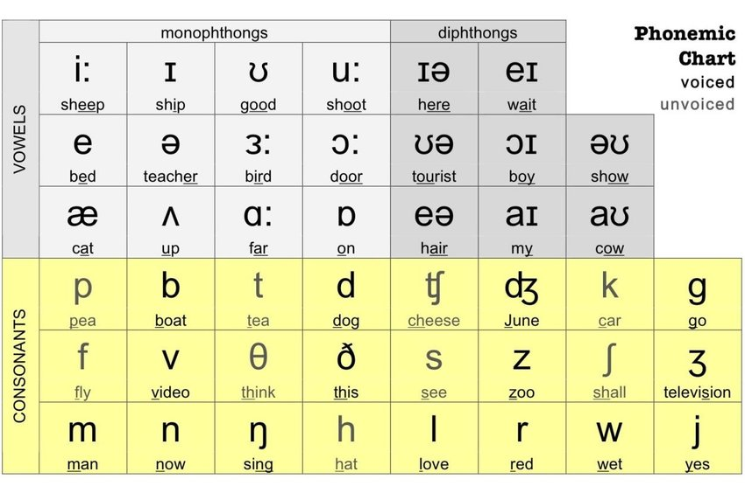
Appendix
Notes:
一般 learning rate 都會根據 batch size 做一些 scale 的操作。這裏用的是lr x batch_size / 256」。
Learning rate 小 under-fitting
Learning rate 大 unstable

